Slide 1






Graduation Internship
03/07/2023 - 08/09/2023
12 Science Avenue, Ghenh Rang, Quy Nhon, Binh Dinh
1

Slide 2




Organic Ecommerce
Member: Tran Quoc Tinh - 19IT5
Mentor: Pham Quoc Khanh
Lecturer: Ngo Le Quan
2

Slide 3






Project Introduction
Table of contents
Technology Used
Features & Demo
Conclusion and Development Direction
3
Summer Internship

Slide 4


Introduction
Scope: Design and build data , develop user interface, create an admin management page.
Introduction: An Ecommerce platform for organic products where users can search, purchase, and learn about fresh food. Admin can easily manage products, categories, and users.
4
Summer Internship

Slide 5








2. Technology Used
MERN stack offers a unified and efficient approach for developing responsive, flexible, and scalable web applications using JavaScript, MongoDB, Express.js, React, and Node.js.
Redux and Redux Toolkit provide an efficient and user-friendly approach for managing the state of web applications.
React Router offers a powerful and intuitive way to handle routing in React applications, enabling efficient navigation and rendering of different components based on the URL.
5
Summer Internship

Slide 6




3. Features & Demo
6
Summer Internship

Slide 7
Completed | Not done yet
Register / Login / Logout | Edit Profile
Search / Add To WishList / Add To Card / Checkout | Add To Compare Product
Filtering / Rating | Multilingual
Add Prodduct | Edit Product, Delete Product
CRUD Brand, Category, Color, Blog, Blog Category, Coupon
Enquiries
7
Summer Internship

Slide 8
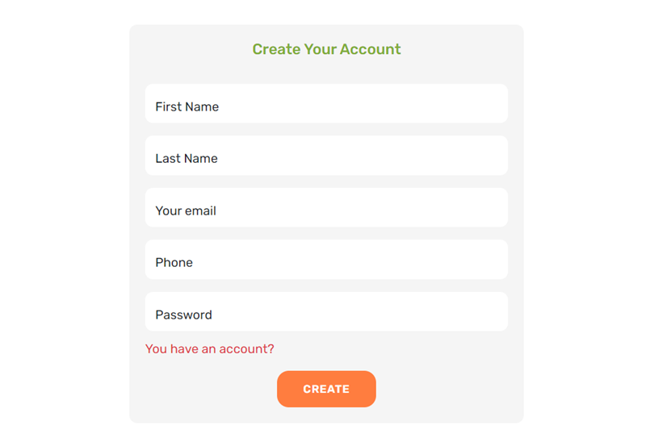
Register
7
Summer Internship

Slide 9
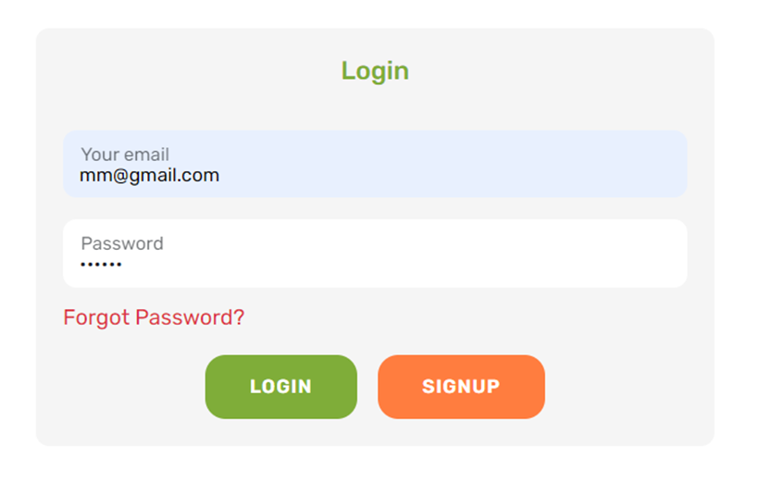
Login
8
Summer Internship

Slide 10
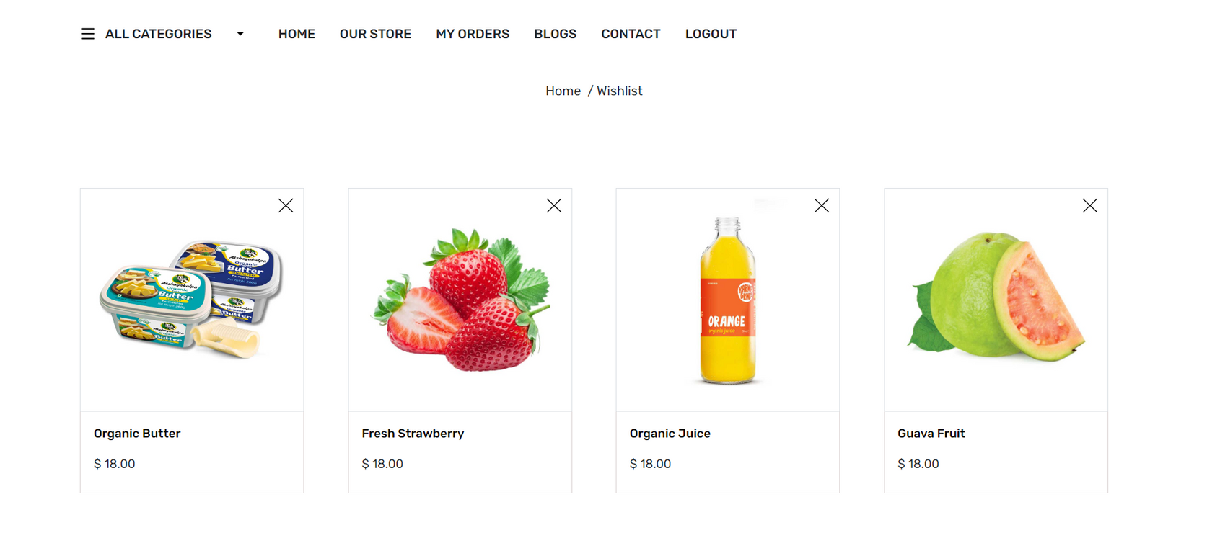
Add Product To WishList
9
Summer Internship

Slide 11
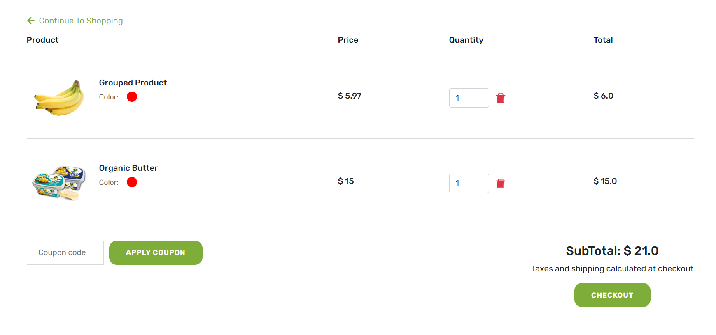
Add Product To Cart
9
Summer Internship

Slide 12
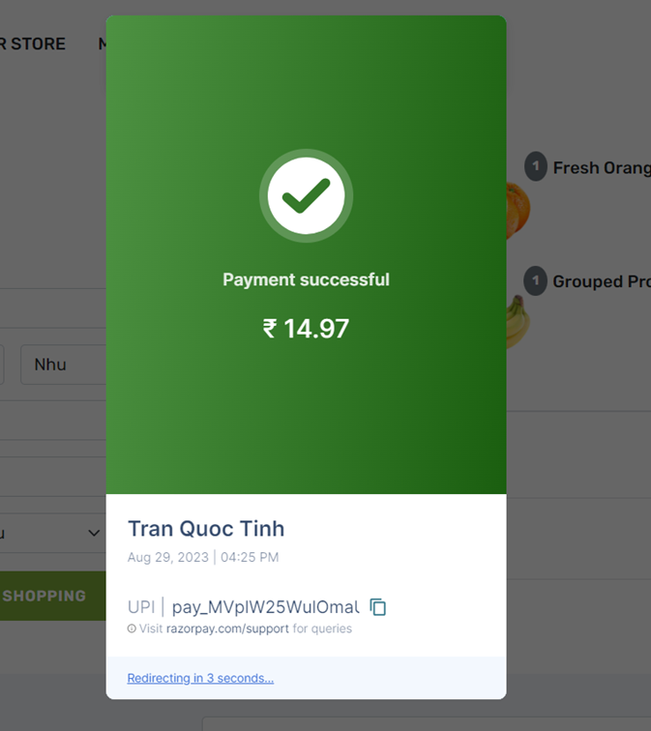
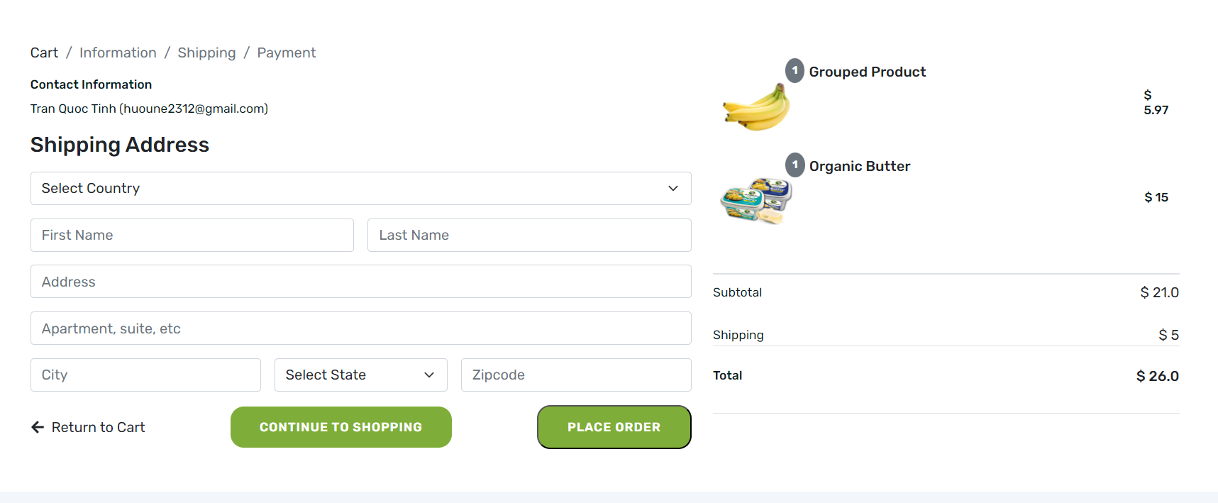
Checkout
10
Summer Internship

Slide 13
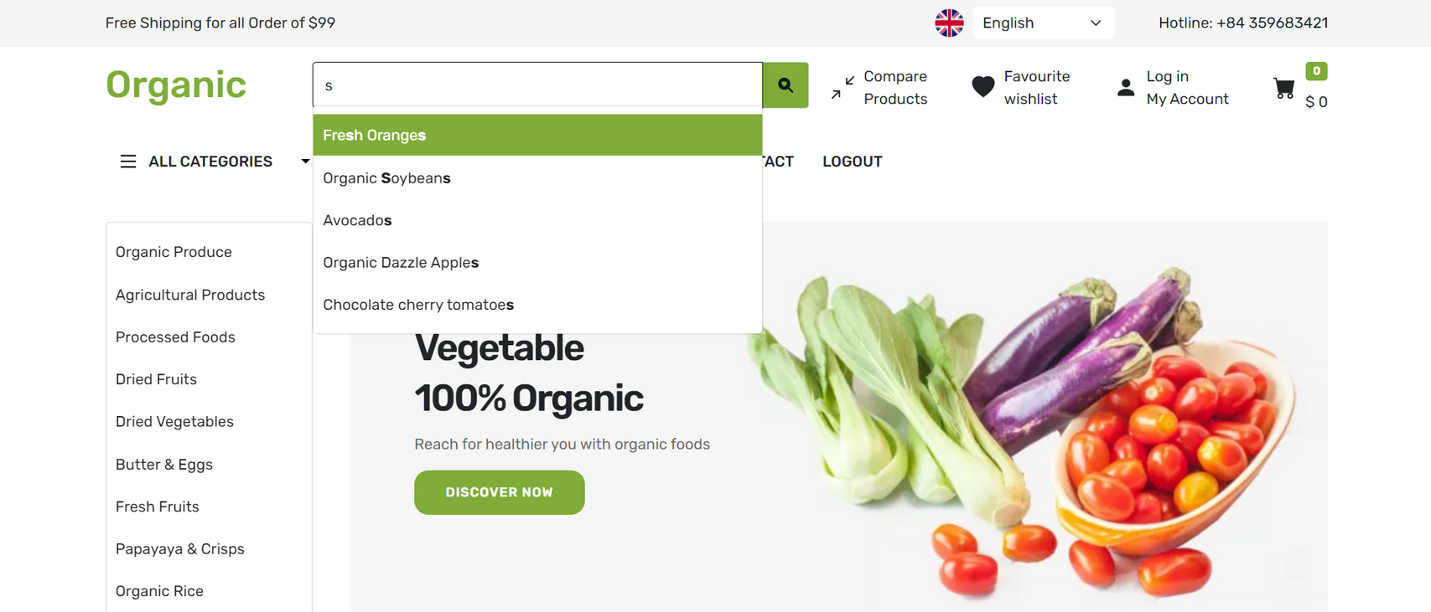
Search
11
Summer Internship

Slide 14
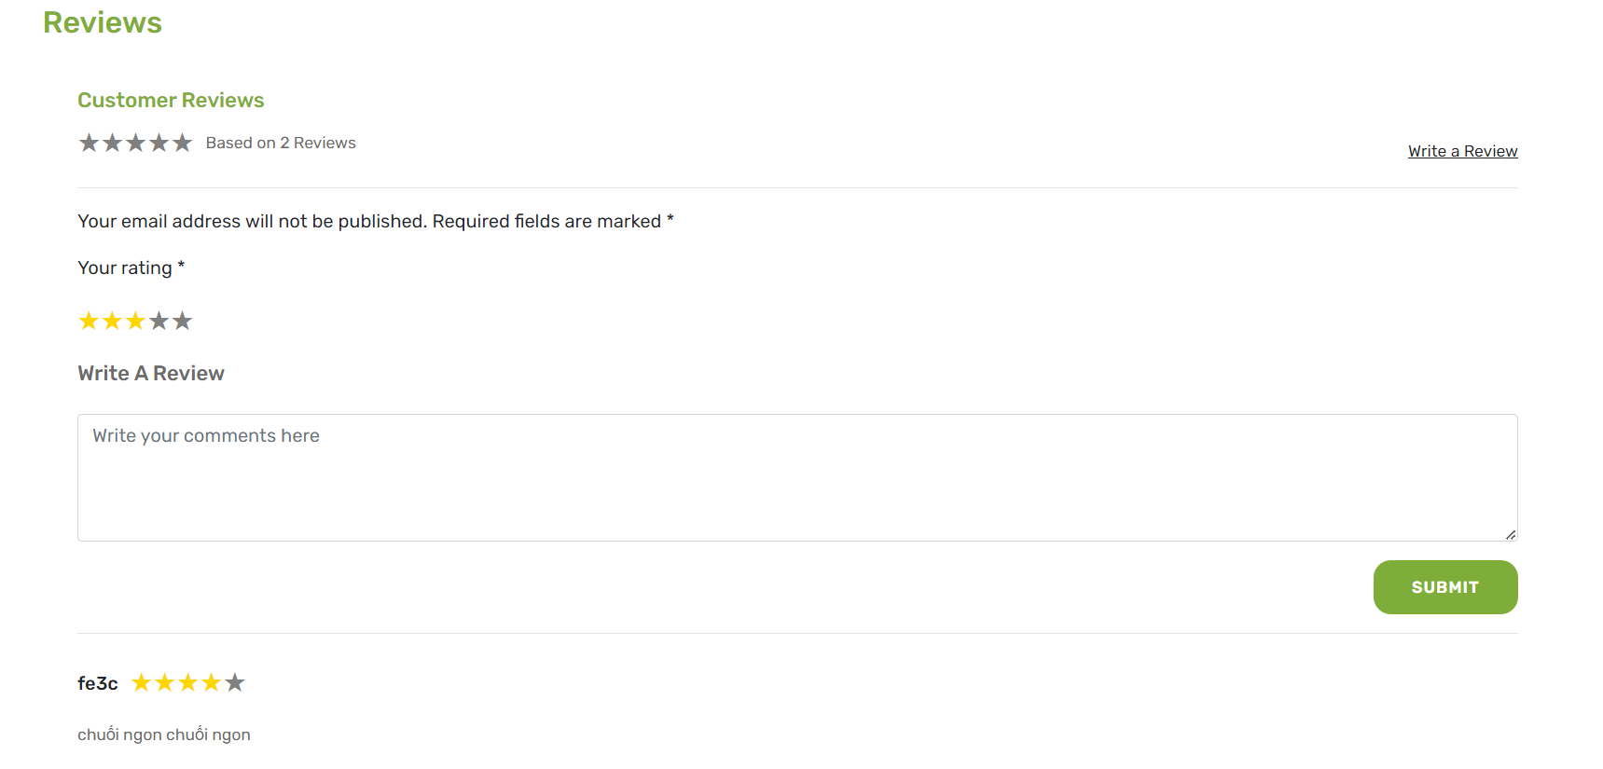
Rating
12
Summer Internship

Slide 15
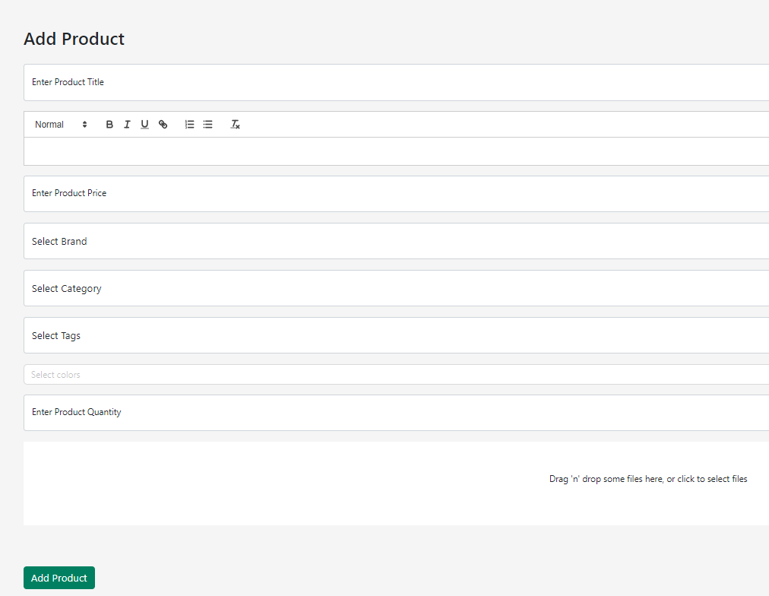
Add product
13
Summer Internship

Slide 16
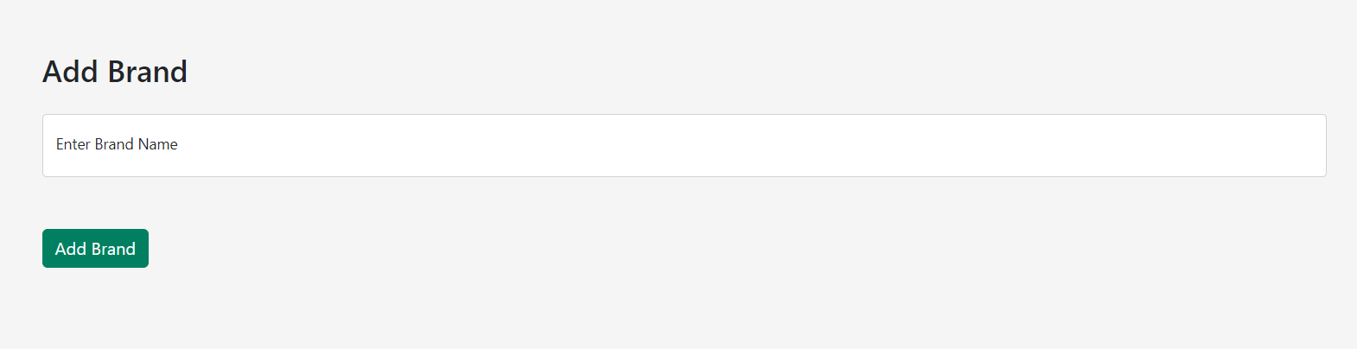
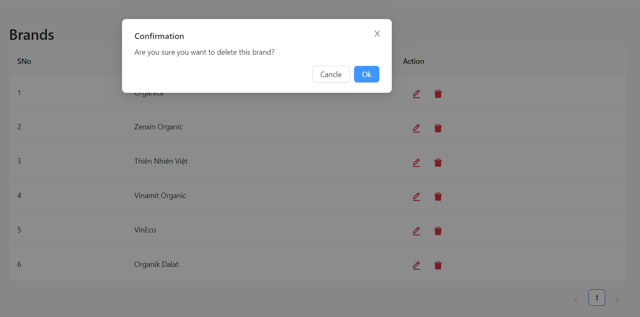
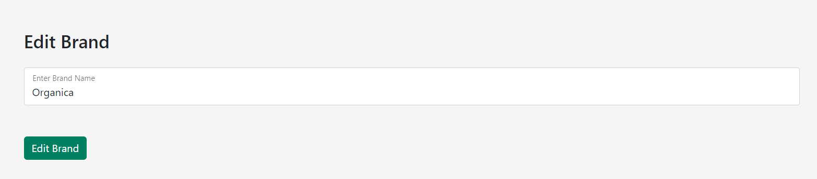
CRUD Brand, Category, Color, ...
14
Summer Internship

Slide 17
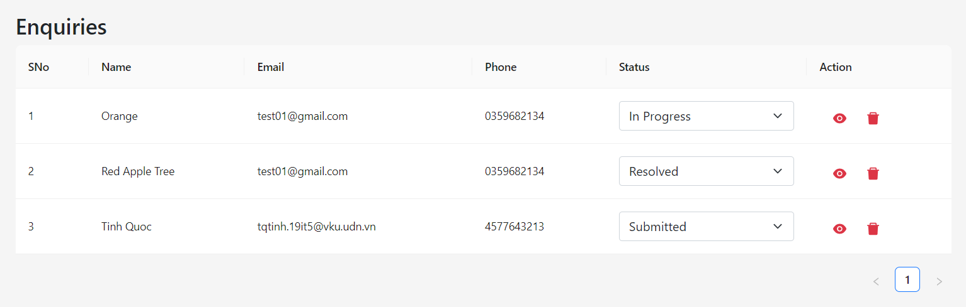
Enquiries
15
Summer Internship

Slide 18
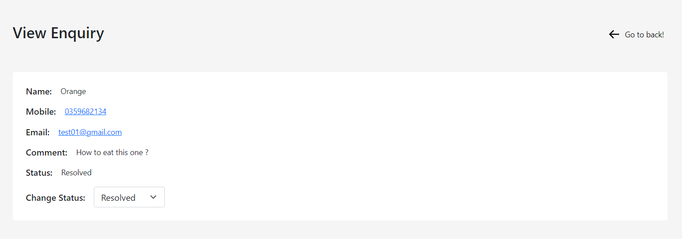
Enquiries
16
Summer Internship

Slide 19

DEMO
17
Summer Internship

Slide 20

4. Conclusion and Development Direction
18
Summer Internship

Slide 21


Conclusion
Achievements:
Applying learned knowledge to the project.
Strong logical thinking, problem-solving skills, and self-learning ability.
Project development process
Limitations:
Limitations in efficiency and optimization in programming and handling functionalities.
Debugging skills.
19

Slide 22

Development Direction
Completing remaining functionalities and expanding advanced features.
Optimizing code and website performance by implementing clear and maintainable logic.
Optimizing the user experience.
20

Slide 23



Thank for listening
Question & Answer !
21

